Slide 1
Colour Management
To Calibrate or Not?

Slide 2
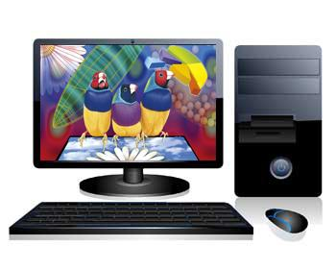
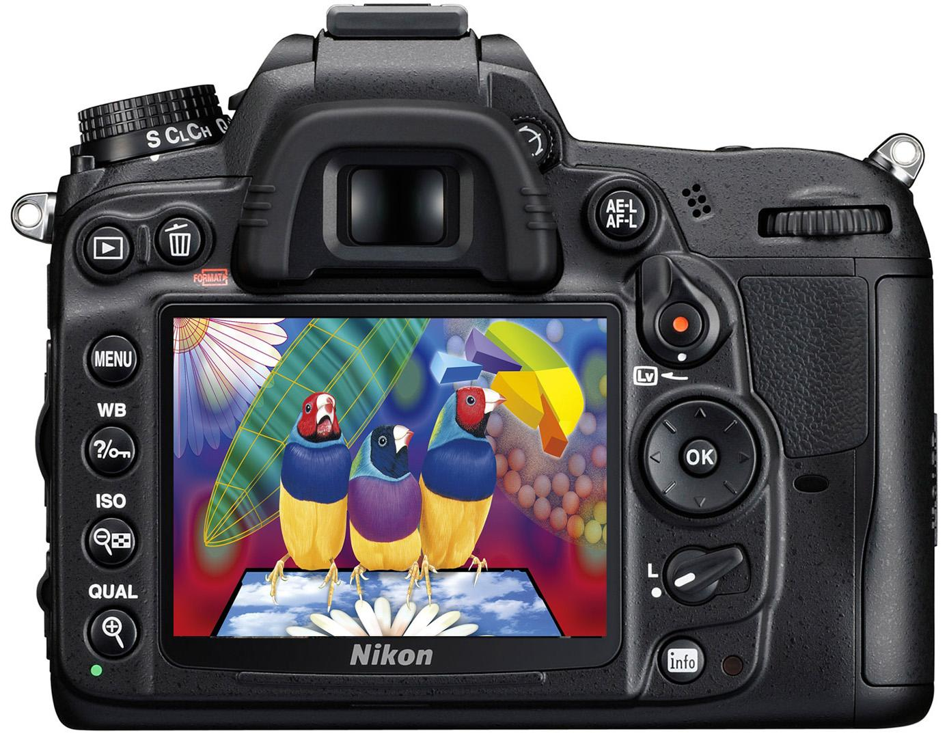
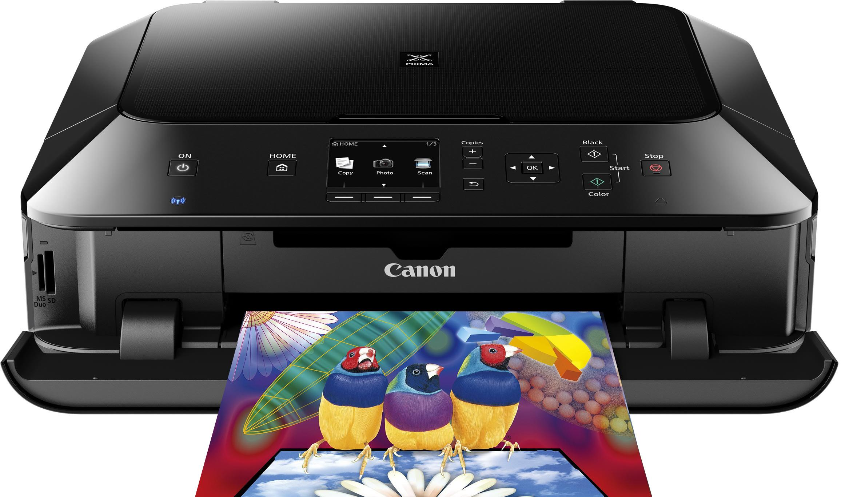
What’s this all about then?

Slide 3
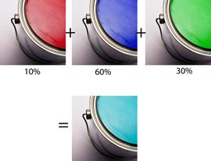
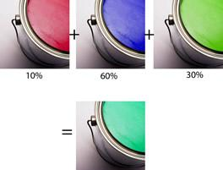
The Problem
Joe paints his boat using three pots of Dulux Paint, he mixes them up with the following ratios. Dave sees Joes boat and wants the same colour Joe gives him the ratios of RGB but Dave uses Crown paints. It is immediately apparent that the colours don’t match. The numbers on their own are not sufficient to accurately define a particular colour. Monitors and printers share this basic problem not all primary colours and inks are the same shade. A common problem is that the print doesn’t look the same as the monitor.

Slide 4
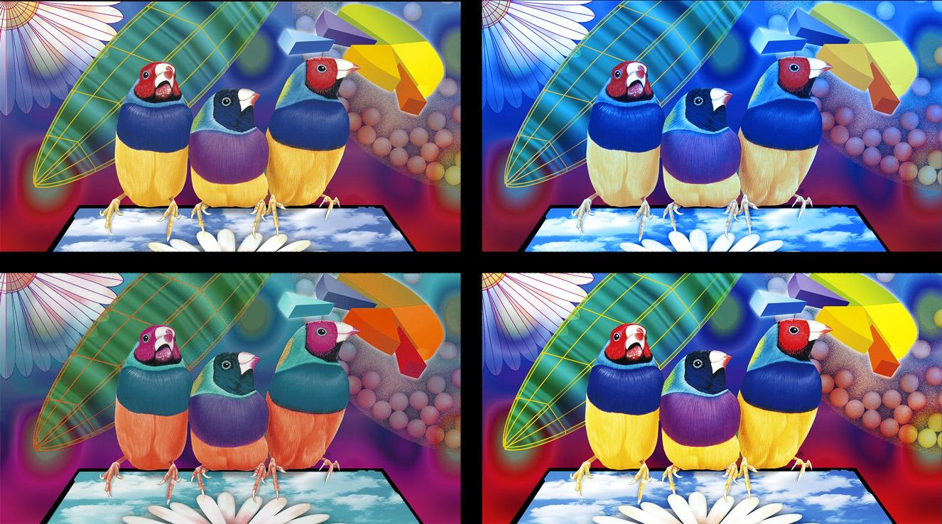

Slide 5
The Solution
The International Color Consortium (ICC) was established in 1993 to create an open, standardized colour management system.
This involves three concepts
colour models or profiles
colour spaces
rendering intents.

Slide 6
ICC Profiles
Describes the colour of the pixels within digital photographic files and therefore the capabilities of monitors, scanners, cameras and printers. For example, it is used to determine exactly how an image will look on your screen.
An ICC Profile tells us:
The darkest tones and colours the file can hold
The lightest tones and colours the file can hold
The range of colours (gamut) that the file is capable of showing
The distribution and relationship between each of those tones and colours
Any device that captures, displays or outputs colour can be described by an icc profile. Colour-aware applications allow the translation between input and output devices.

Slide 7
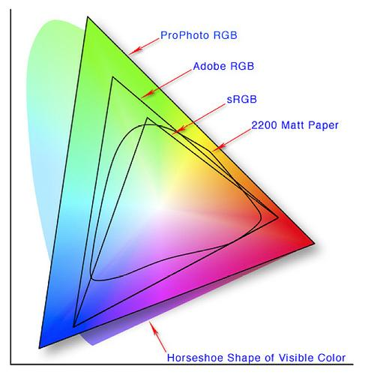
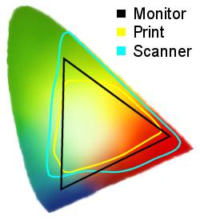
Colour Spaces

Slide 8
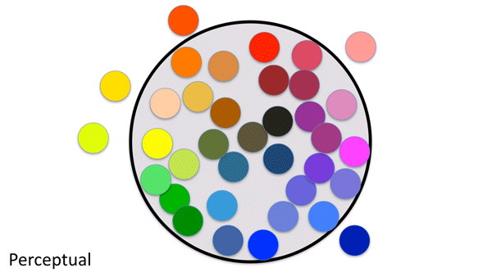
Rendering Intent - Perceptual
If the gamut of the source space is wider than that of the destination space, all colours are compressed to fit the destination space. If the colours of the source space are smaller than the destination no change is made.

Slide 9
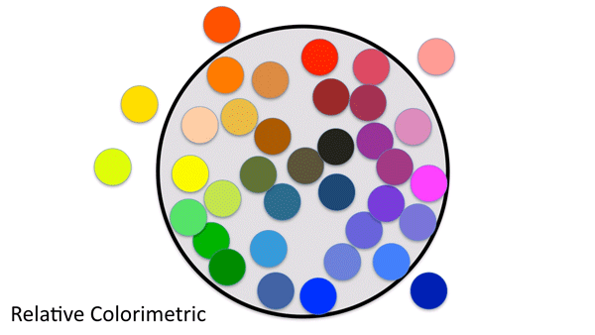
Rendering Intent - Relative Colorimetric
If the gamut of the destination space is smaller than the source, identical colours are mapped 1:1. All colours that are not present in the destination space are mapped to the closest colour, usually at the edge of the colour space. The white point is mapped to the white point of the destination if they differ. This may result in different colours in the source space being mapped to the same colour. This is the rendering intent used with monitors.

Slide 10
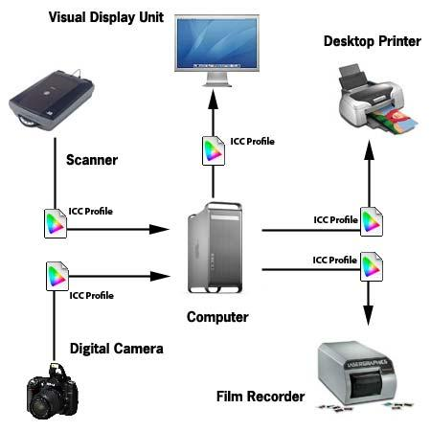
Colour Management System (CMS)
The goal of colour management is to maintain colour consistency across devices.
It requires a fully colour-managed application (Photoshop, Lightroom, Chrome, etc.) that reads and 'applies' an input profile and converts it to a custom 'calibrated' monitor profile for displaying, and/or a printer profile for printing.
Web Browser
Flickr
Etc….
Professional Lab

Slide 11
Why Calibrate?
Because if your monitor and or printer is not properly calibrated, then you will most likely not see everything in the image as it was intended to be seen and the imaged viewed and or printed will lack any predictability.
Because you’ve just bought an expensive camera and or printer…
Because calibration can be quite simple and relatively easy to perform.
Because your a photographer and it matters how other people see your images.
No reason, modern cameras, software and printers take care of everything!

Slide 12
Colour Management Examples
Photoshop
Lightroom
Chrome
Opera

Slide 13
Get your camera settings right
Colour Space: Adobe RGB or sRGB?
White Balance
Exposure
RAW or JPEG?

Slide 14
Monitor Calibration
Calibration is the process of setting the monitor to the desired neutral output and includes settings for resolution, luminance, white point and gamma.
Profiling is the process of measuring the imperfections in the monitor against a known reference, and creating a "filter" that compensates for those imperfections. Using a hardware device (Colorimeter or Spectrophotometer), that hangs over the monitor screen and reads several sets of red, green, blue and grey patches generated by the profiling software. The colour patches are measured by the puck as they are displayed. The differences between the colours the monitor displays in its native state and the true colours of the patches are used to create a monitor profile causing the monitor to display the true colours more closely than its native state.

Slide 15
What Type of Monitor do You Have?
This is important to know, because effective colour calibration depends on constant colour accuracy of your monitor.
TN (Twisted Nematic) – the most popular and cheapest used by almost all manufacturers. Great for watching movies and playing games, because they have fast refresh rates. But they have very limited viewing angles and in most cases, cannot accurately reproduce colors. In addition, these monitors can only represent 6-bits of color unable to display true 24-bit colour; instead having to resort to dithering and therefore they are only capable of displaying a very limited gamut of colours.
IPS (In-Plane Switching) – compared to TN, IPS monitors are true 8-bit (full color reproduction with no dithering), have much wider viewing angles and are capable of accurately reproducing a much bigger color gamut. They are more expensive and are primarily used for professional photography and design. Many of the high-end Apple screens, including the new iPad.
MVA (Multi-domain Vertical Alignment) – sits between TN and IPS, offering good viewing angles and fast refresh rates, better brightness and colour reproduction than TN, but definitely worse than IPS. Similar to IPS, MVA monitors are also 8-bit.
PVA (Patterned Vertical Alignment) – an alternative version of MVA, but with a higher contrast ratio. The latest “S-PVA” offers excellent viewing angles, fast response times, 8-bit colour gamut and very good colour reproduction.

Slide 16
Visual vs Hardware Calibration
To accurately profile a monitor, the colours that the screen outputs need to be analysed and compared with real colours.
Visual calibration is difficult as you are relying on both your vision and perception of colours. That said, there are free tools and websites that allow you to get close and improve on a non-calibrated monitor
Hardware calibration works by analysing the colours by an external device that does colour and gamma comparisons, then generates a custom profile which allows automated corrections to be applied to colours and gamma via proprietary software.

Slide 17
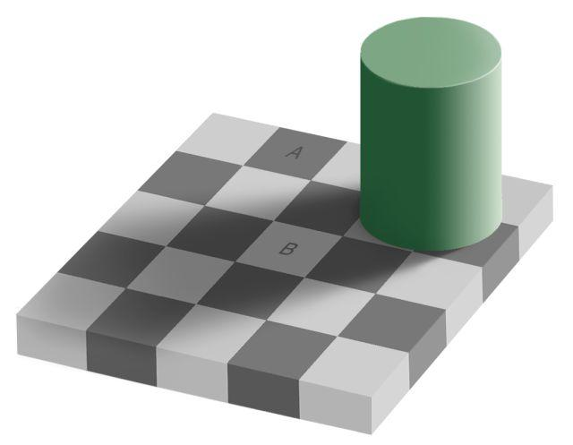

Slide 18
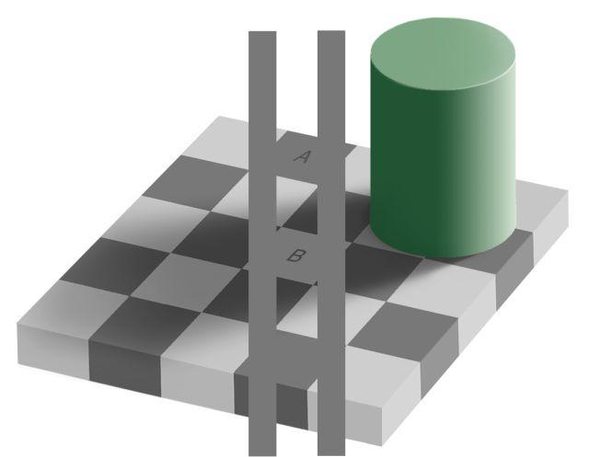

Slide 19
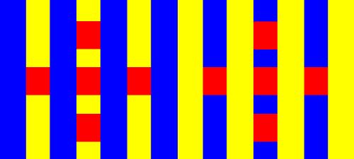

Slide 21
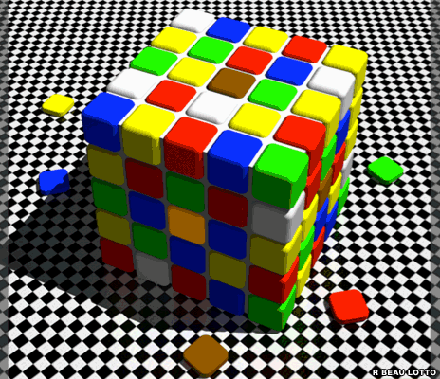

Slide 23
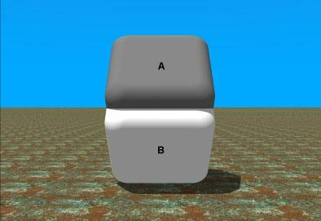

Slide 24
Software Calibration
https://www.photofriday.com/calibrate.php
http://displaycalibration.com/
http://www.calibrize.com/
http://tft.vanity.dk/monitorTest_scale.html
http://www.lagom.nl/lcd-test/
http://www.quickgamma.de/indexen.html (download utility)
Windows built-in software calibration
Mac built-in software calibration

Slide 26
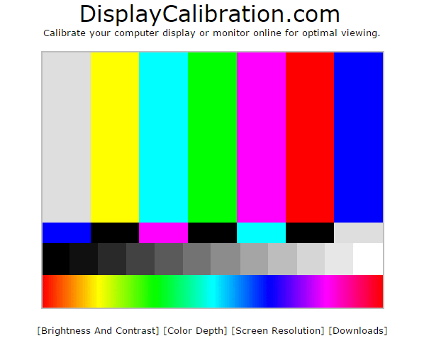

Slide 27
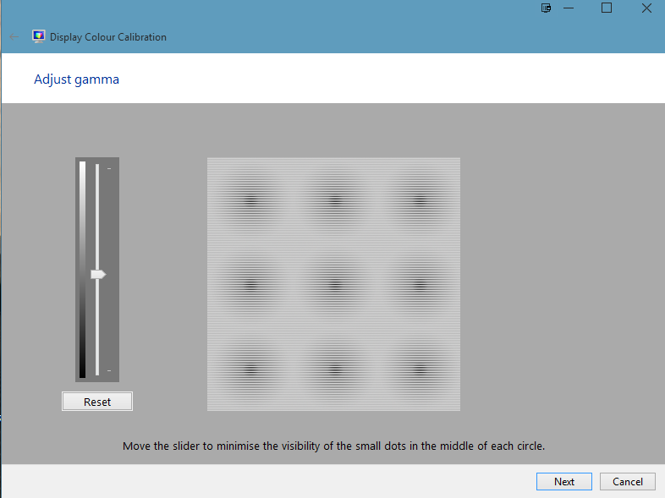
Windows Colour Calibration
From the Windows Search Box
enter “calibrate display”
Execute Calibrate Display Color.
Follow the on-screen prompts.

Slide 28
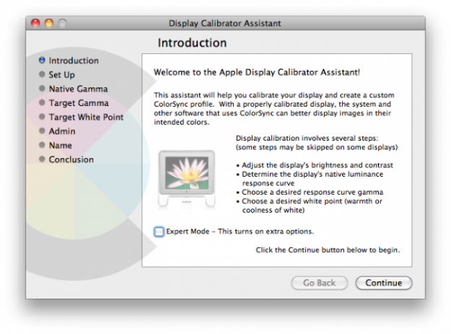
Apple Mac Colour Calibration
From the Apple Menu choose
System Preferences => Displays,
Color and then Calibrate.
Display Calibrator Assistant
walks you through calibrating
your display and then creates a
calibrated colour profile.

Slide 29
Calibration Procedure - Generic
Turn on your monitor at least a half hour before calibration so the monitor can warm up to its normal operating temperature and conditions.
Set your monitor’s resolution to its native, default screen resolution.
Make sure your calibrating in a room with moderate ambient lighting. The room doesn’t need to be pitch black, but you don’t want the sharp glares and color casts resulting from direct light.
Familiarise yourself with your monitor’s display controls. They may be located on the monitor itself, on the keyboard, or within the operating system control panel.

Slide 30
Calibration Procedure - Colorimeter
Plug the colorimeter into the computer.
Launch the calibration software that came with the device.
When prompted, select the values for gamma and color temperature. If you do mostly print work set gamma to 1.8 and 5000°K (D50). If you create mostly web graphics, game assets, or other images viewed on screen, choose gamma 2.2 and 6500°K (D65).
Follow the instructions to have the colorimeter measure your monitor’s colors and make any necessary adjustments.
Two of the most important settings are gamma and color temperature, both of which are fairly difficult concepts to understand.

Slide 31
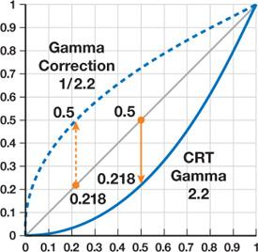
Gamma Encoding & Correction
CRTs do not behave linearly in their conversion of voltages into light intensities. Although modern LCD monitors do not inherently have this property, they are usually constructed to mimic the response of CRTs.
Gamma is the relationship between the numerical value of a pixel in an image file and the brightness of that pixel when viewed on screen.
What this means is that if your monitor gamma isn't set correctly, then you haven't a hope of seeing colours and tones the way that they'll appear on other people's monitors; and they won't see your images the way that you intended either. You might also have difficulty matching the output of a printer to your monitor.
Gamma correction is a way of compensating for this non-linear relationship between voltage and brightness

Slide 32
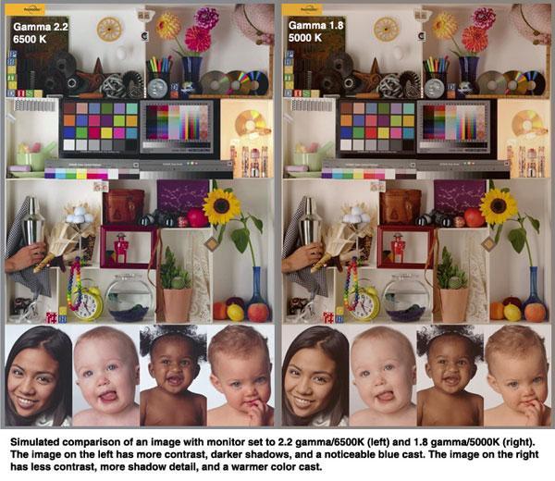
Gamma
Varying the amount of gamma correction changes not only the brightness, but also the ratios of red to green to blue.

Slide 33
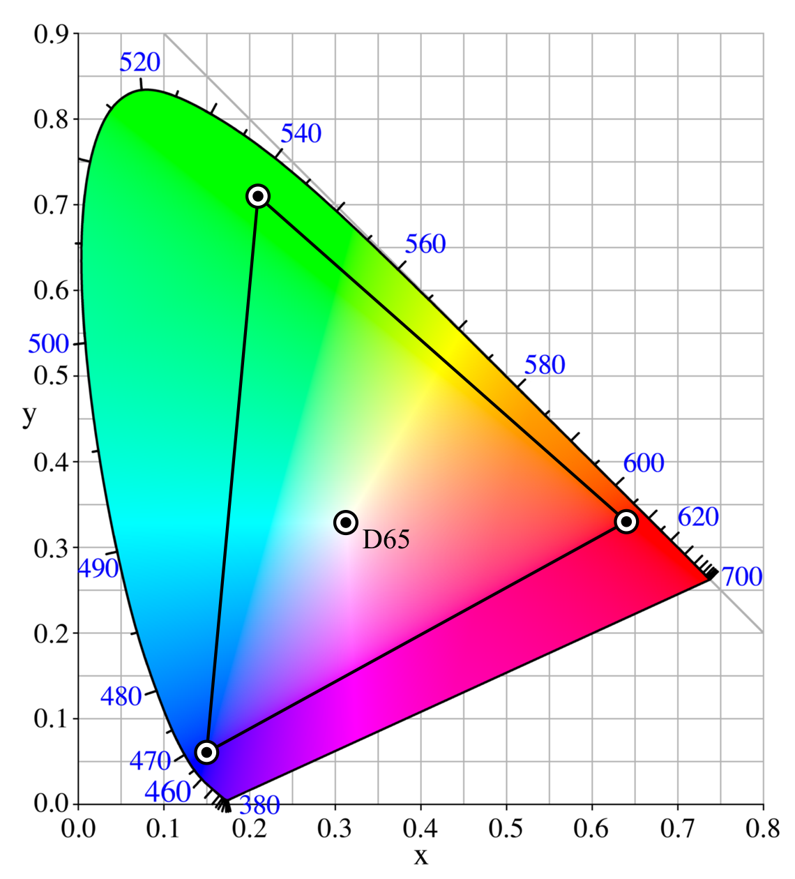
Colour Temperature
A colour temperature of 6500 K is standard for ordinary PC use and for the sRGB standard. Most LCD monitors offer a setting of 6500 K among their color temperature options. If a monitor offers an sRGB mode, setting it to this mode should present no problems.

Slide 34
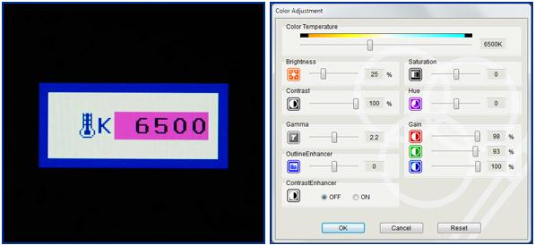
Colour Temperature
Monitor OSD enabling users to set color temperature by Kelvin value.

Slide 35
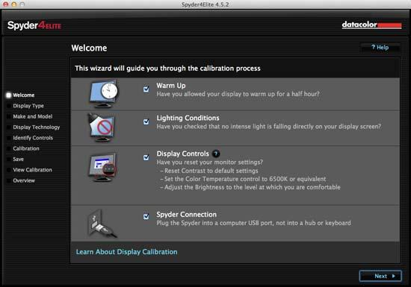
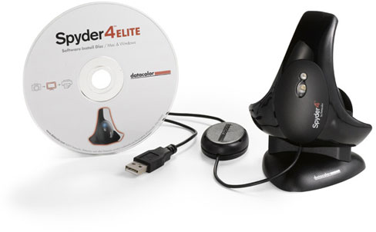
Hardware Calibration
The Datacolor Spyder4 Elite can be used to calibrate monitors, projectors, laptops, TVs, iPads and even smartphones.

Slide 36
Colour Management

Slide 38
Glossary
ICC | In color management, an ICC profile is a set of data that characterizes a color input or output device, or a color space, according to standards promulgated by the International Color Consortium.
Gamut | The complete range or scope of something: in this context it is the complete range of colours a device is capable of producing..
Gamma | Defines the relationship between a pixel's numerical value and its actual luminance. With a digital camera, when twice the number of photons hit the sensor, it receives twice the signal (a "linear" relationship). However, our eyes perceive twice the light as being only a fraction brighter — and increasingly so for higher light intensities (a "nonlinear" relationship).
CMS | Colour Management System

